Slide 1
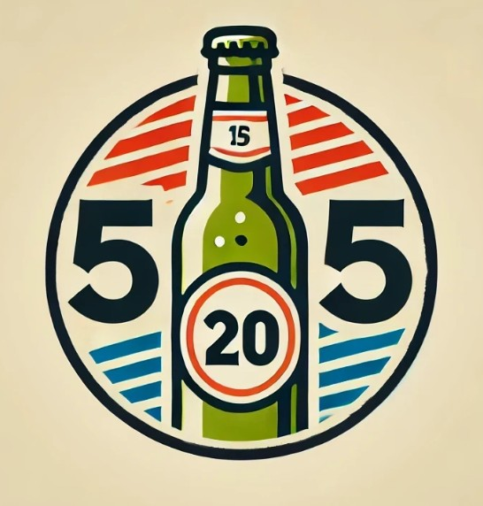
Brain Stimulation Game
Single Player Beer-Punch
Group 10
An AI Interacting Game that Prevent Dementia

Slide 2
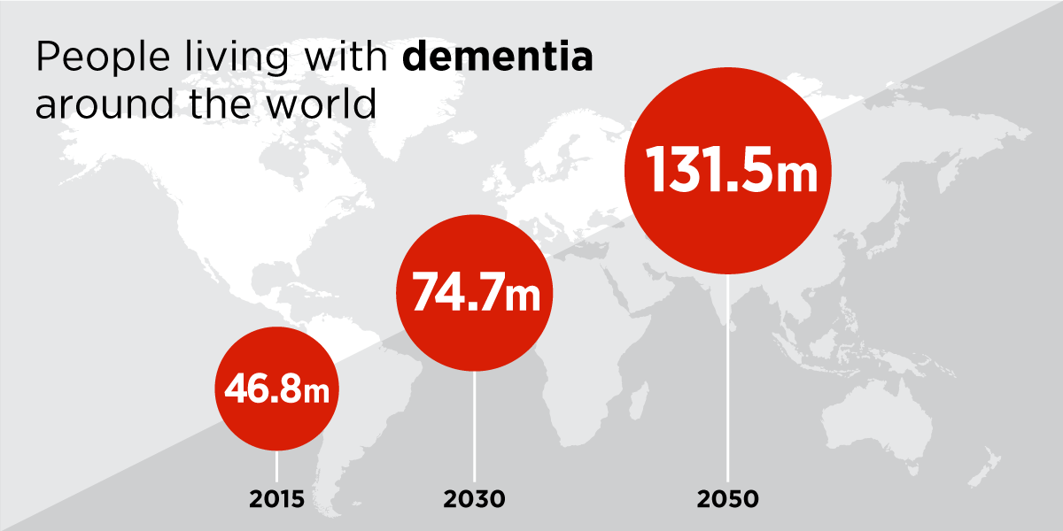
Background
With the aging of the elderly population becoming more and more serious, 131 million people will suffer from dementia by 2050.
Fingers are one of the most sensitive parts of the human body, and the brain regions responsible for controlling the hands and fingers occupy one-third of the brain's surface area[1].
Recent study suggests that finger exercise can improve cognitive function and potentially delay the progression of MCI to dementia.[2]
[1]Li, Ping; Deng, Yongning; Guo, Xiaojuan; Wang, Jin(2021)Nursing effects of finger exercise on cognitive function and others for cerebral ischemic stroke patients ,American journal of translational research. , 2021, Vol.13(4), p.3759-3765
[2]Wang, J., Xie, J., Li, M., Ren, D., Li, Y., He, Y., ... & Liao, S. (2022). Finger exercise alleviates mild cognitive impairment of older persons: A community-based randomized trial. Geriatric Nursing, 47, 42-46.

Slide 3
An interactive system that combines finger movements with cognitive function tests

Slide 4







User flow
5
15
Show
React
Identify

Slide 5
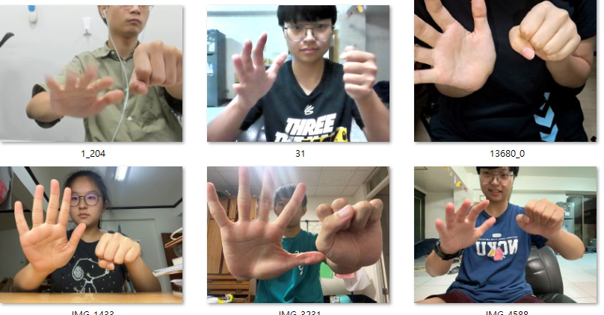
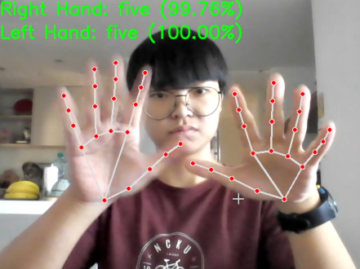
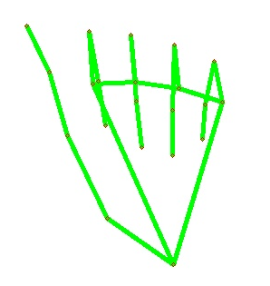
Image Generation & Label
MediaPipe Landmark System

Slide 6
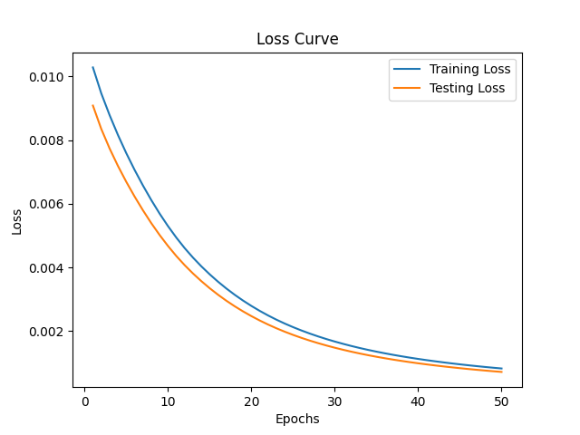
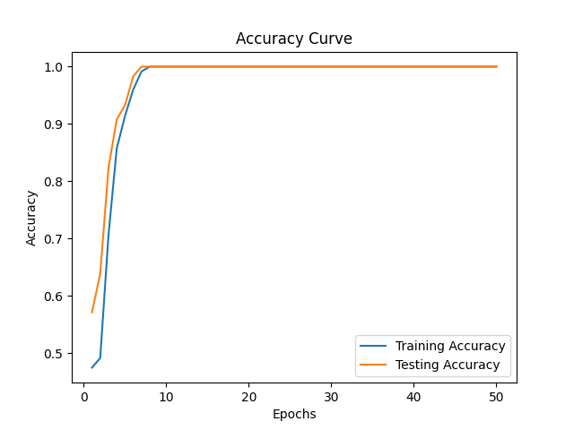
Different models training result
ResNet18
CNN
VGG16
YOLO
With labeled image
SVM
MLP
With MediaPipe Landmark
Learning curve for MLP

Slide 7
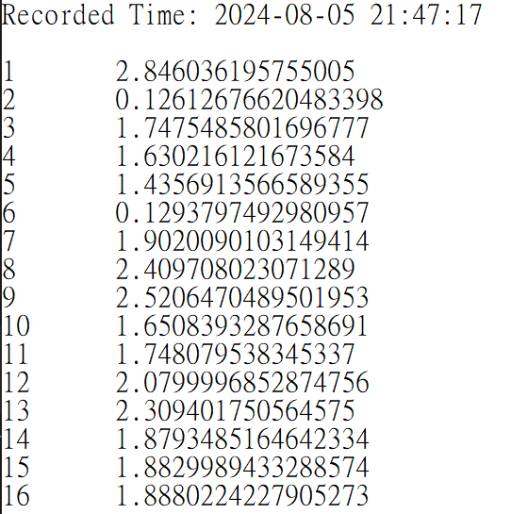
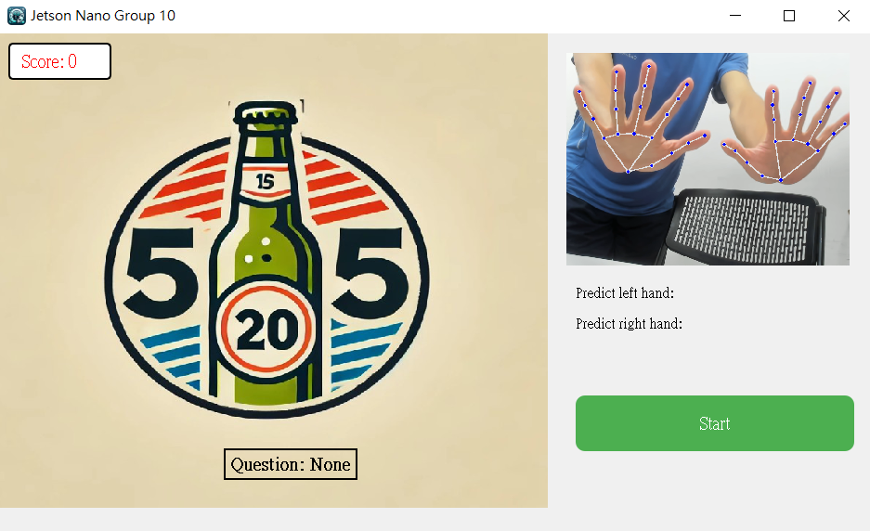
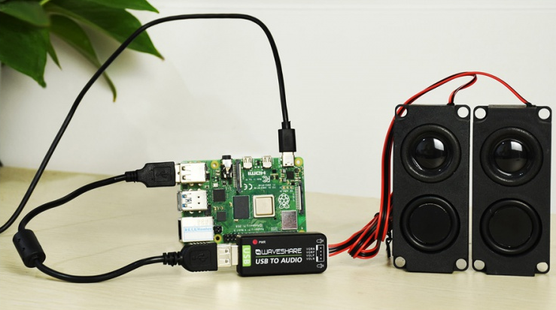
Response Time and Score Calculation
Response time recorded every time when playing
Every 0.5 second the system will detect if the user make the right gesture. The user could get maximum of 6 points per round.
This could act as an important data for follow-up studies, such as pre and post-tests, or to study an individual's progress or impairment in cognitive functioning.
USB sound card for more complete design

Slide 8
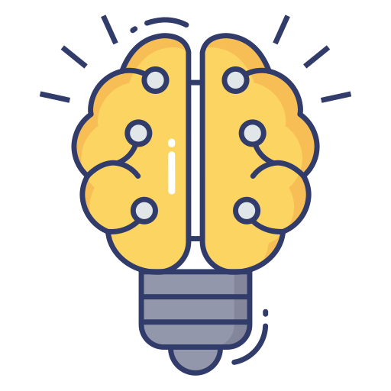

THANK YOU

